Slide 1
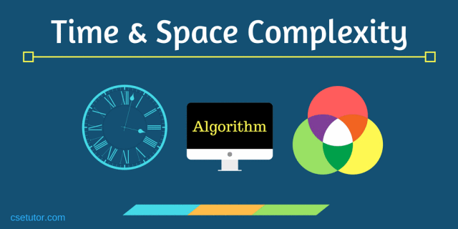
CSE214: Algorithms
Computational complexity
‹#›

Slide 2
Today’s Contents
Computational complexity
Asymptotic Notation
Why Complexity Analysis is needed?
‹#›

Slide 3
Computational complexity
In computer science, the computational complexity or simply complexity of an algorithm is the amount of resources required to run it.
The study of the complexity of problems is called computational complexity theory.
Particular focus is given to Time and Memory requirements.
Amount of resources required to run an algorithm generally varies with the size of the input
‹#›

Slide 4
Complexity Analysis of Algorithm
Time Complexity
Space Complexity
‹#›

Slide 5
Complexity Analysis of Algorithm
Time Complexity
Time complexity is generally expressed as the number of required elementary operations on an input of size n, where elementary operations are assumed to take a constant amount of time on a given computer and change only by a constant factor when run on a different computer.
2. Space Complexity
Space complexity is generally expressed as the amount of memory required by an algorithm on an input of size n.
‹#›

Slide 6
Understanding of Time and Space Complexity
Design an algorithm to add two numbers and display the result
Algo-1:
1. START
2. declare three integers a, b & c
3. Input in a & b
4. c a+b
5. print c
6. STOP
Algo-2:
1. START
2. declare three integers a & b
3. Input in a & b
4. print a+b
5. STOP
Time =
Space =
6 sec
12 Bytes
Time =
Space =
5 sec
8 Bytes
‹#›

Slide 7
Three Cases of Complexity Analysis
Usually, complexity analysis of an algorithm falls under three types −
1. Best Case | Minimum number of steps required for program execution.
2. Average Case | Average number of steps required for program execution.
3. Worst Case | Maximum number of steps required for program execution.
‹#›

Slide 8
Asymptotic Notations
Following are the commonly used asymptotic notations to calculate the running time complexity of an algorithm.
1. Big-O (oh) Notation | Used to represent the Worst case.
2. Big-Ω (Omega) Notation | Used to represent the Best case
3. Big-θ (Theta) Notation | Used to represent the Average case
‹#›

Slide 9
Understanding of Three cases
and Asymptotic Notation
Example: 01
Search an element in an Array.
5 | 6 | 3 | 8 | 1 | 31
Best case =
Worst case =
Average case =
Ω (1)
O (n)
θ (n/2) = θ (n)
‹#›

Slide 10
Understanding of Three cases
and Asymptotic Notation
Example: 02
Sort the element in an Array.
5 | 6 | 7 | 8 | 10 | 31
Best case =
Worst case =
Average case =
Ω (n)
Already Sorted Array
‹#›

Slide 11
Understanding of Three cases
and Asymptotic Notation
Example: 02
Sort the element in an Array.
5 | 6 | 3 | 8 | 1 | 31
Best case =
Worst case =
Average case =
Ω (n)
O (n * n) = O (n²)
θ (n * n) = O (n²)
Unsorted Array
‹#›

Slide 12
Best, worst and average case
It’s difficult to estimate the exact running time.
We are usually interested in the order of growth of the running time of an algorithm, not in the exact running time.
• Best case depends on the input
• Average case is difficult to compute
• So we usually focus on worst case analysis
Easier to compute
Usually close to the actual running time
‹#›

Slide 13
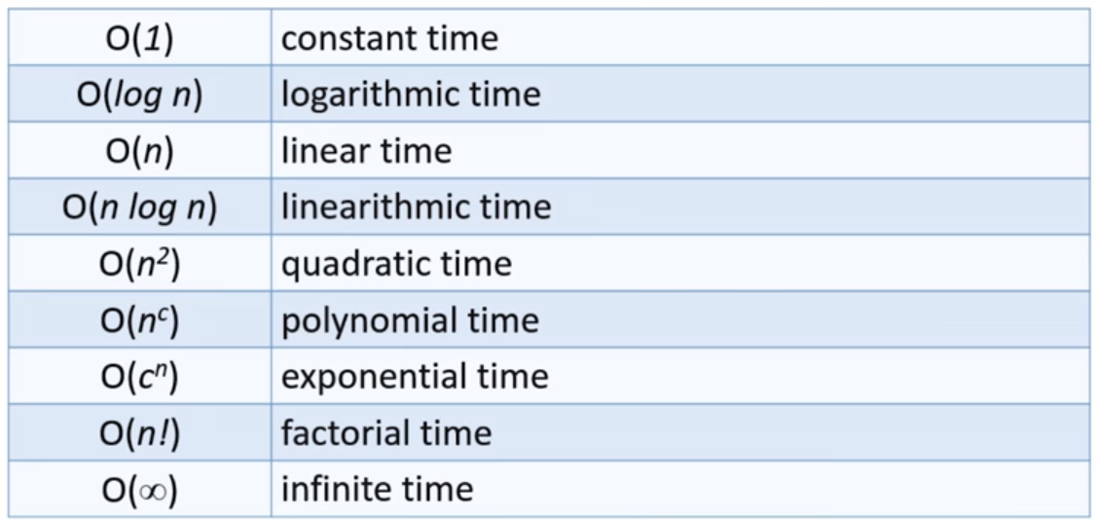
Some common rates of growth
Let n be the size of input to an algorithm, and k some constant. The following are common rates of growth.
‹#›

Slide 14

Thank you!
‹#›

